Slide 1
Project: 🎵 ReadAssist
A Serverless Text-to-Speech Solution on AWS
Indira S. E. Fiadzomor

Slide 2
Problem
Reading long text is time-consuming and not always accessible
Limited hands-free content consumption options
Accessibility challenges for visually impaired user
Growing need for multilingual support in digital tools

Slide 3
Solution - ReadAssist
Convert text into lifelike speech
Translate into 8 major languages before TTS
Multiple voices (male/female, US/UK)
Instant streaming or downloading
Delivered via secure serverless architecture

Slide 4
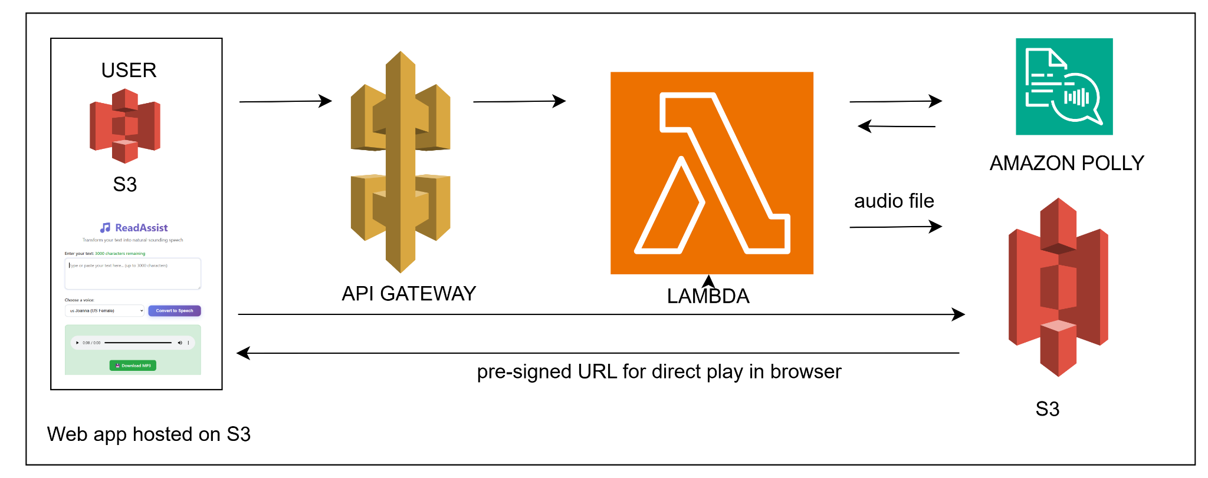
Architecture Diagram

Slide 5
Architecture Overview
Frontend: Static website on Amazon S3
API Gateway: Secure endpoints
AWS Lambda: TTS & translation compute
Amazon Polly: Text-to-Speech engine
Amazon S3: Audio storage & signed URLs
GitHub Actions: Automated deployments

Slide 6
Frontend Stack and Features
HTML5 - Structure and semantic markup
CSS3 - Styling with modern features (flexbox, gradients, animations)
Vanilla JavaScript - Pure JS with modern ES6+ features (async/await, fetch(), template literals, arrow functions)
No Framework - Zero dependencies, no React/Vue/Angular
Web APIs: Fetch API for HTTP requests, DOM manipulation
Responsive Design: Mobile-first approach with media queries

Slide 7
Features
Natural-sounding speech (Amazon Polly)
Multiple voices & accents
Web-based audio playback
MP3 download option
Secure input validation & CSP
Rate limiting & character limit
Automated CI/CD pipeline

Slide 8
Frontend - Why Vanilla JS?
Lightweight: No bundle size overhead
Fast Loading: No framework download/parse time
Simple: Perfect for this single-page application
Modern: Uses latest web standards
This is a pure web standards approach - clean, fast, and dependency-free! Perfect for a simple TTS application that doesn't need the complexity of a full framework.

Slide 9
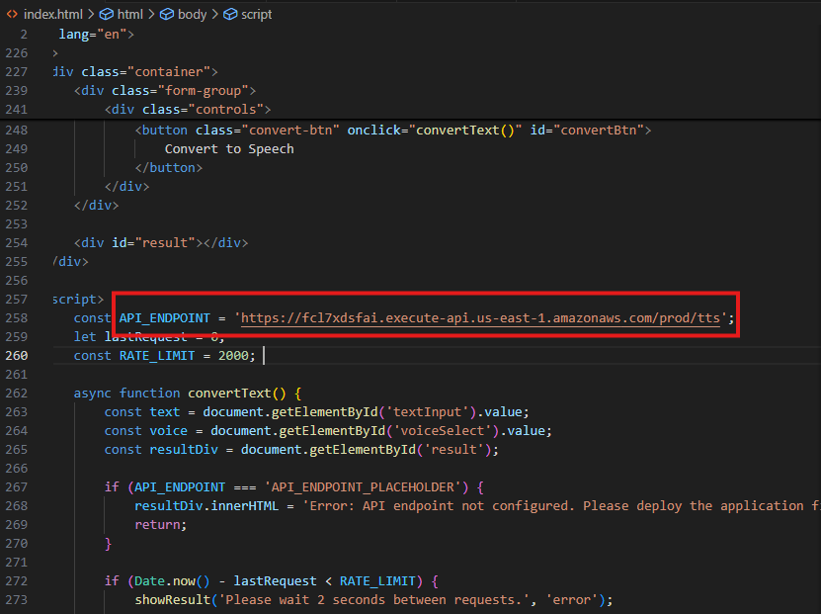
Frontend:
A screenshot of index.html linked to API endpoint

Slide 10
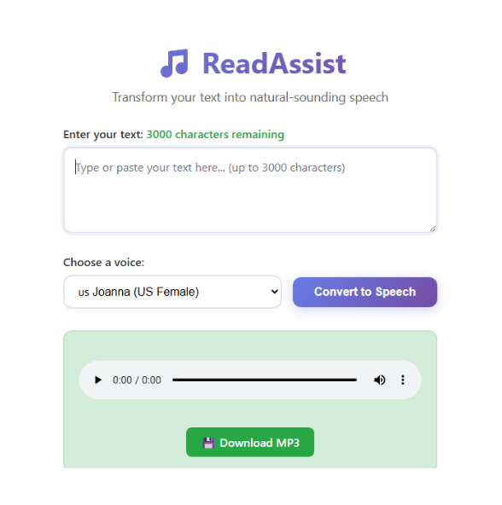
Frontend:
A screenshot of the Web app UI Demo video

Slide 11
Backend Stack and Features
AWS Lambda - Serverless compute (Node.js 20.x runtime)
AWS SDK v3 - AWS service clients (@aws-sdk/client-polly, @aws-sdk/client-s3)
Vanilla Node.js - Pure JavaScript, no Express/Fastify/Koa
API Gateway - HTTP API routing and CORS
CloudFormation - Infrastructure as Code

Slide 12
Backend - Why Serverless?
No Framework: Direct Lambda handler, no Express overhead
Auto-scaling: Handles traffic spikes automatically
Pay-per-use: Only charged when processing requests
Managed: No server maintenance required
Fast: Cold start optimized with minimal dependencies
This is pure serverless architecture - the Lambda function directly handles HTTP events from API Gateway without any web framework layer. Maximum efficiency for this use case!

Slide 13
Backend - Iac: Cloudformation
The CloudFormation template provisions a complete serverless TTS infrastructure:
Storage (S3): WebsiteBucket - Static website hosting for frontend & AudioBucket - Storage for generated MP3 files
Bucket policies - Public read access and CORS configuration
Security (IAM): LambdaRole - Execution role with permissions for: Polly TTS service access, S3 read/write operations and CloudWatch logging
Compute (Lambda): TTSFunction - Node.js 20.x runtime with embedded code, Environment variables - S3 bucket name configuration & 30-second timeout - For TTS processing

Slide 14
Backend - Iac: Cloudformation
API Layer (API Gateway): TTSApi - REST API with regional endpoints, TTSResource - /tts endpoint path, TTSMethod - POST method for TTS requests, TTSOptionsMethod - CORS preflight handling and TTSDeployment - Production stage deployment
LambdaPermission - Allows API Gateway to invoke Lambda
Outputs: WebsiteURL - S3 HTTP URL, ApiEndpoint - API Gateway endpoint URL, Bucket names - For deployment scripts
Result: Complete serverless TTS application with HTTPS, global CDN, and secure API access!

Slide 15
CI/CD Pipeline - Github Actions
Automation Benefits
Zero-touch deployment - Push code → Live app
Rollback capability - CloudFormation stack management
Security - AWS credentials in GitHub Secrets
Result: Every push to main automatically deploys the complete TTS application with updated infrastructure and frontend!
Trigger: Push to main branch
AWS Authentication: GitHub Secrets for credentials
Infrastructure: CloudFormation deployment
Frontend: S3 website upload

Slide 16
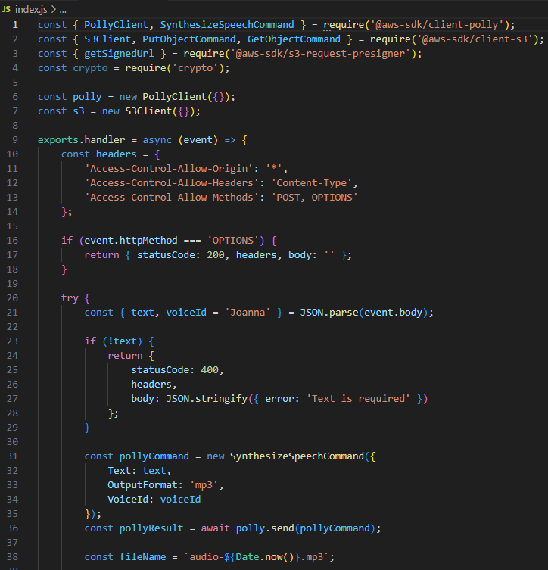
Backend:
A screenshot of index.js snippet (Lambda function)

Slide 17
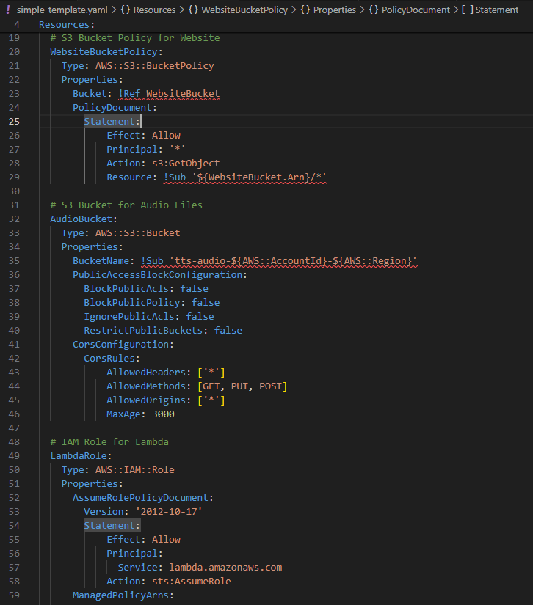
Backend:
A screenshot of cloudformation template

Slide 18
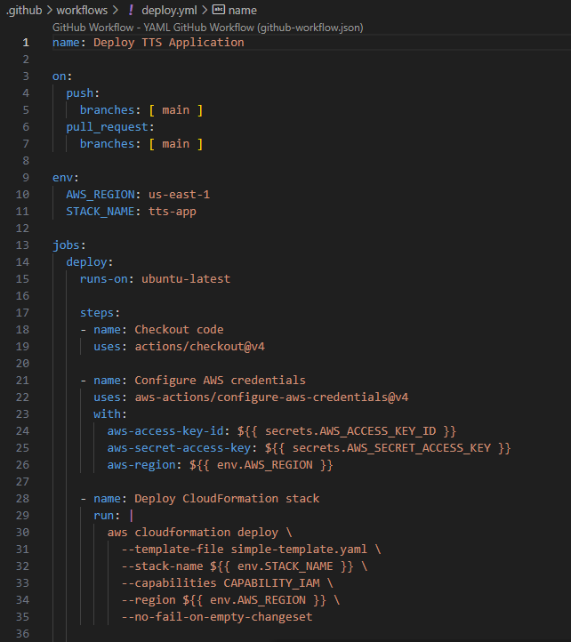
Backend:
A screenshot of deploy.yml

Slide 19
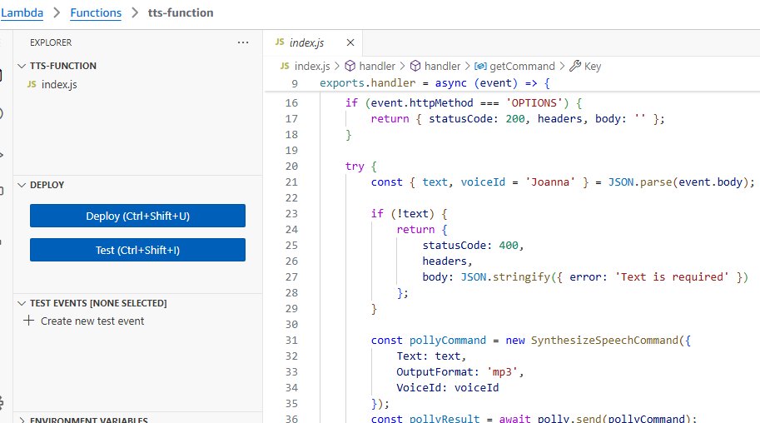
Lambda function as provisioned in AWS console

Slide 20
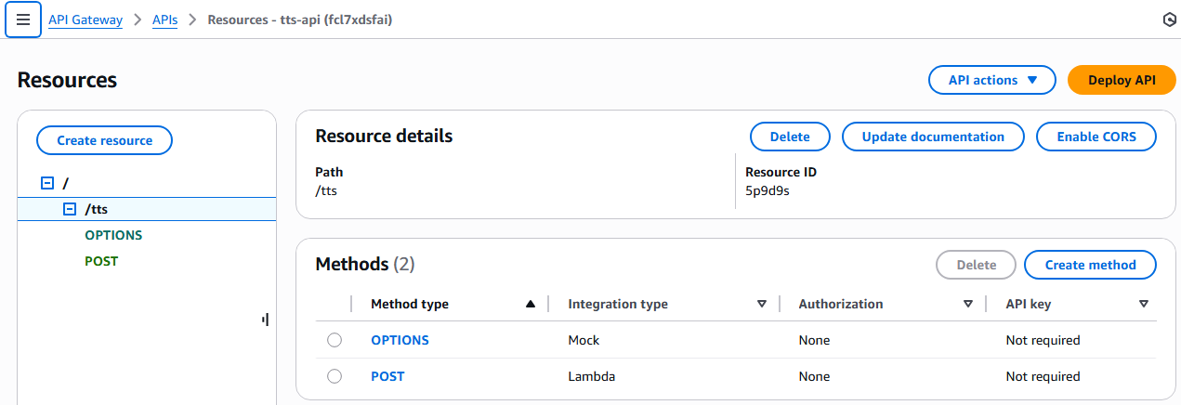
AWS API Gateway: REST API provisioned

Slide 21
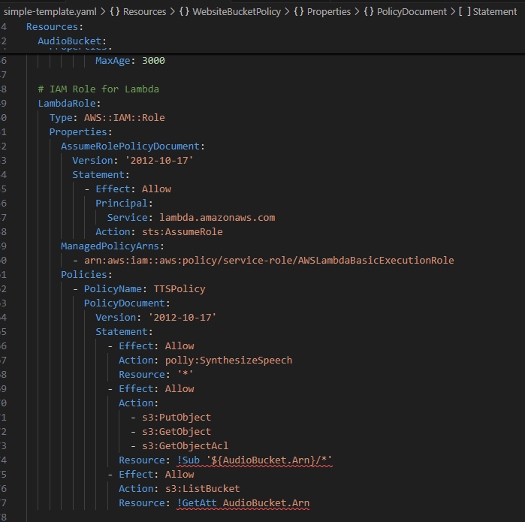
IAM role for lambda

Slide 22
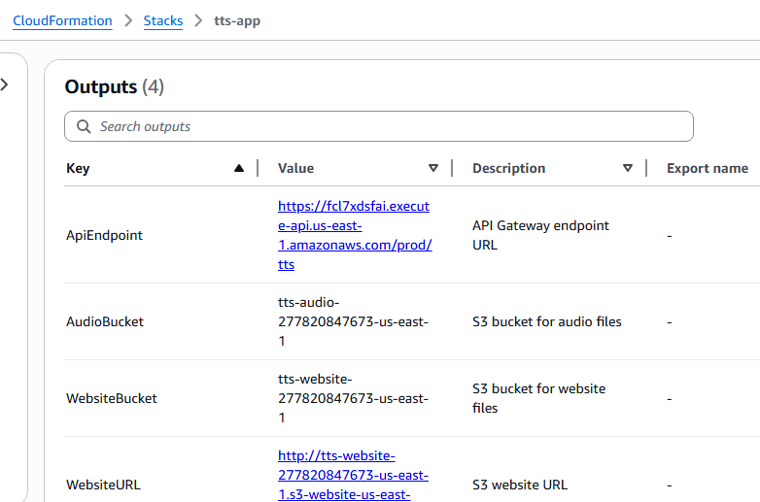
Tts-app stack deployed in Cloudformation

Slide 23
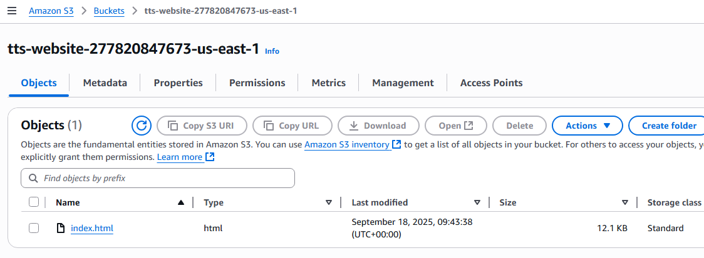
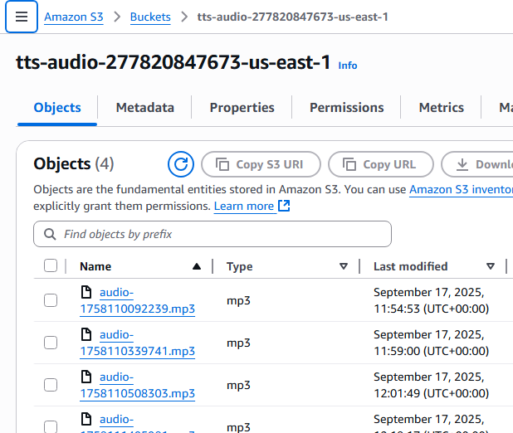
S3 bucket for hosting
S3 bucket for audio storage

Slide 24
Challenges & Mitigation
📈 Scalability Limits – Monitor API Gateway & Lambda quotas
💾 Storage Costs – Enable S3 lifecycle rules & cost alerts
🔐 Security & CORS – Apply strict IAM, rate limiting, and secure headers
🎙️ Limited Voice Options – Gradually add more voices and accents
🛠️ CI/CD Reliability – Automate tests, monitor GitHub Actions failures
💰 API Cost Management – Track usage, set billing alarms, explore freemium model

Slide 25
Conclusion & Next Steps
ReadAssist makes text accessible, multilingual, and hands-free
Combining serverless scalability with AI-driven TTS & translation
Enabling learning, accessibility, and productivity for all
Next Steps & Ideas for Expansion:
Include text translation
Expand voice library with more languages/accents
Develop mobile-friendly PWA version
Add authentication for personalized storage
Explore API monetization model

Slide 26

Thanks!
Contact us:
Indira S. E. Fiadzomor
www.linkedin.com/in/indira-fiadzomor
https://indirafiadzomor.wixsite.com/indira-fiadzomor
Github: sefira
indira.fiadzomor@gmail.com

